Slide 1
IHEP SUSY Group Meeting
Chengxin Liao
Institute of High Energy Physics Chinese Academy of Sciences Jul 9, 2025

Slide 2



Fake Factor for Run2 and Run3
$0<|η|<1$
$1<|η|<1.37$
$1.52<|η|<2.5$
Selection:
nBaseTau == 1
nBaseLep >= 1, SigLep >= 1 MET trigger, MET >= 200
Same-Signal(Orthogonal with SR) bVeto ID: nMediumTau == 1 antiID: nMediumTau < 1
A small bump show in the last bin
Wait for wenyi’s result to cross-check

Slide 3
Pre-Selection
HH Pre-selection
>= 2 medium taus
0 base lepton
MET ≥ 150; pass MET trigger
1≤nJet
Opposite-sign hadronic-hadronic tau pair
bveto
jet pt>100 GeV
LH Pre-selection
>= 1 medium taus
1 base lepton, 1 signal lepton
MET ≥ 200; pass MET trigger
1≤nJet
Opposite-sign lepton-hadronic tau pair
bveto
jet pt>100 GeV

Slide 4
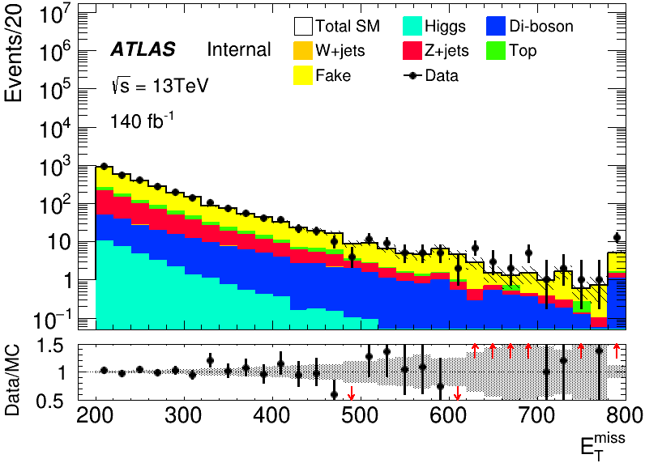
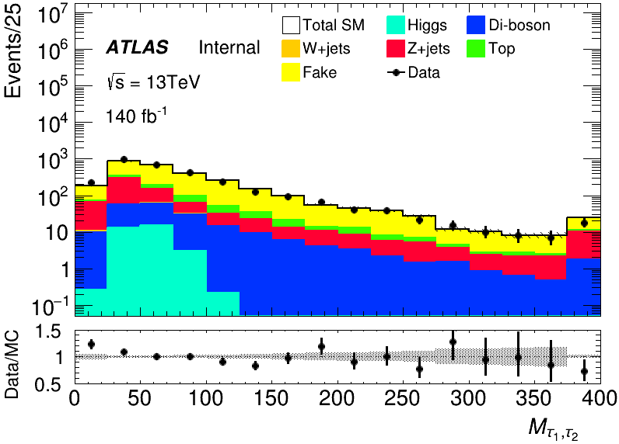
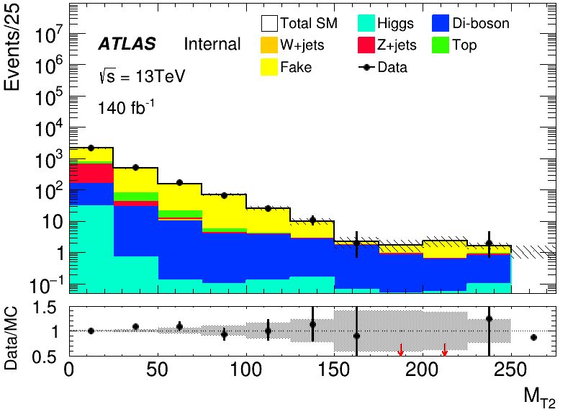
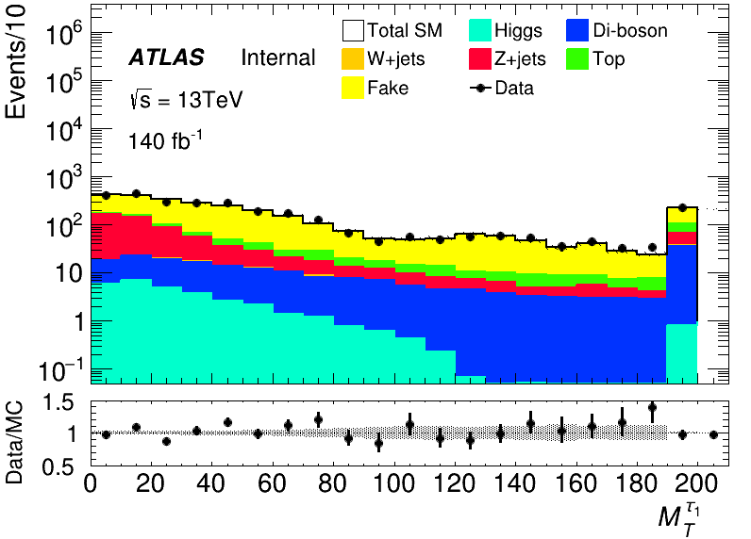
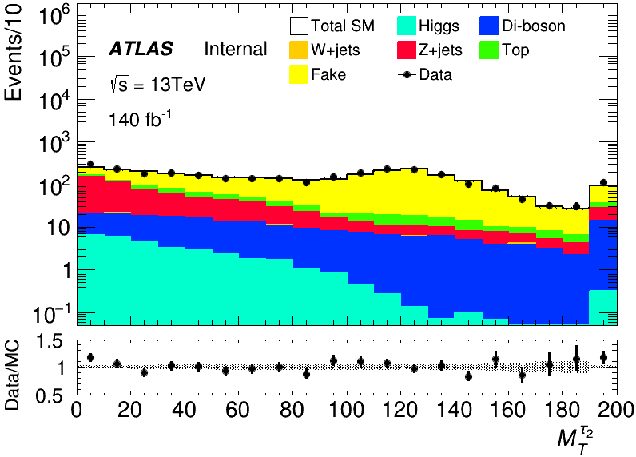
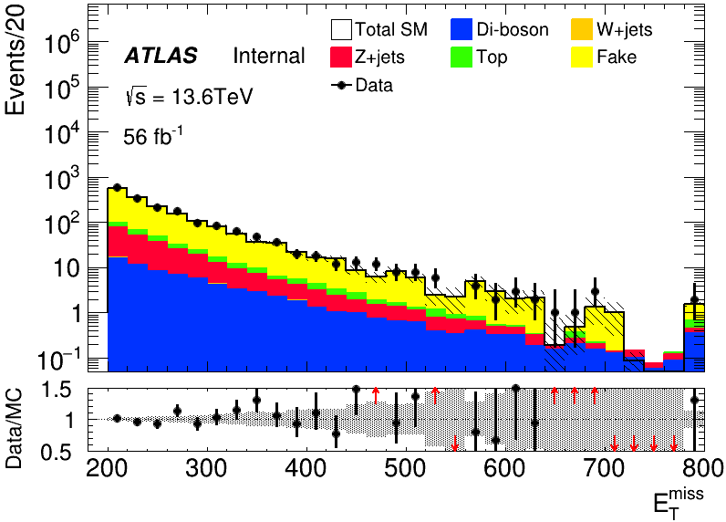
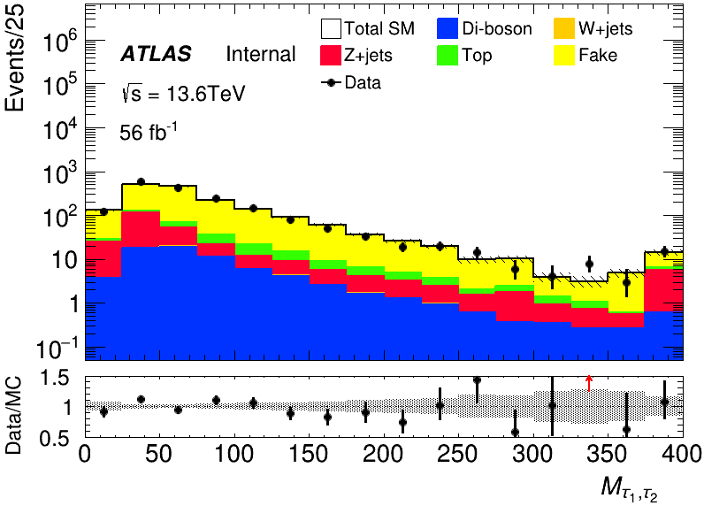
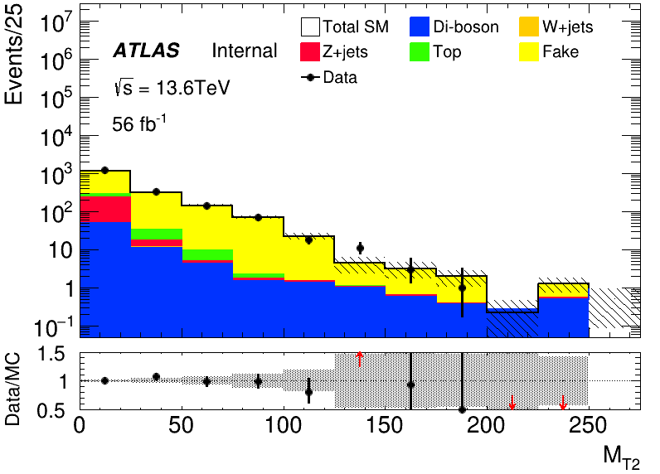
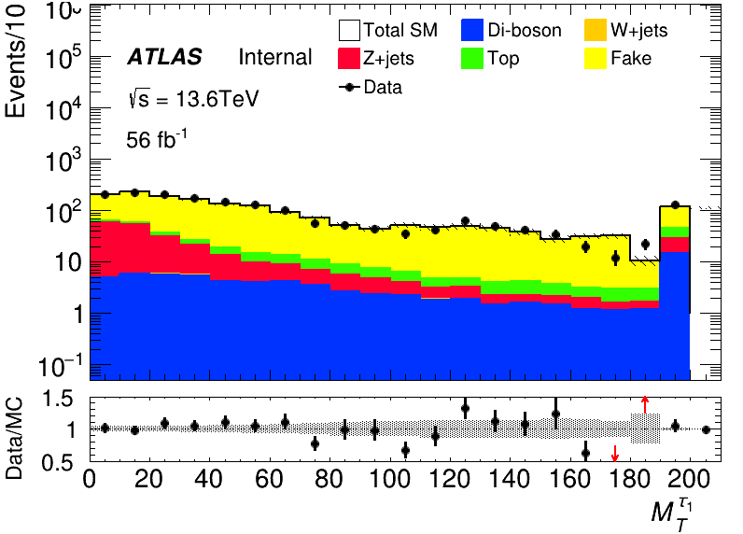
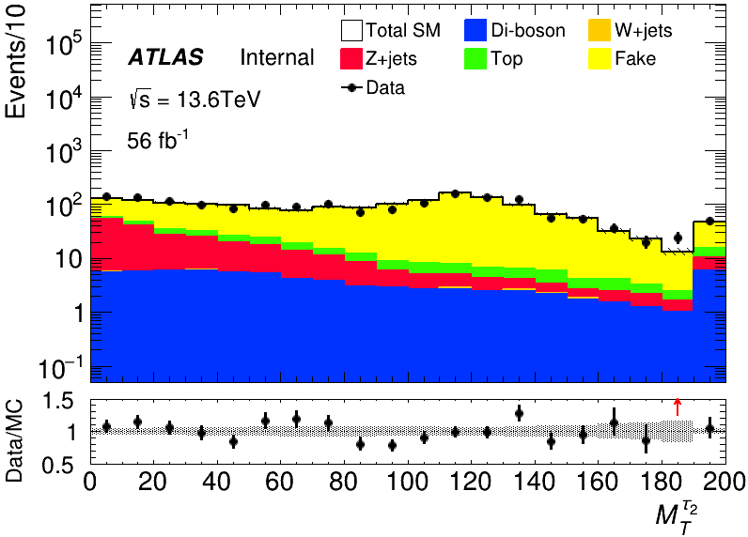
MC modeling in Pre-Selection(HH)
run2
run3

Slide 5
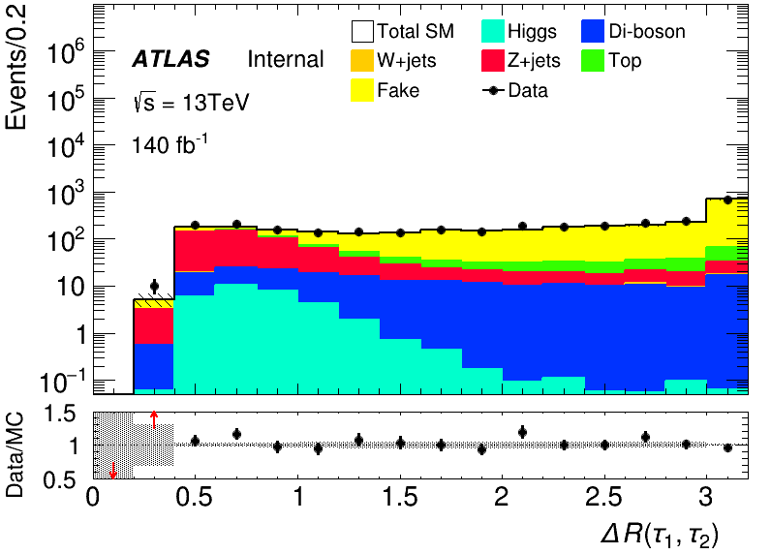
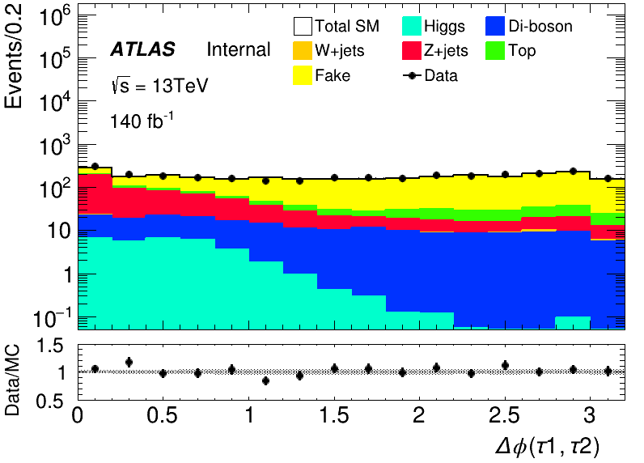
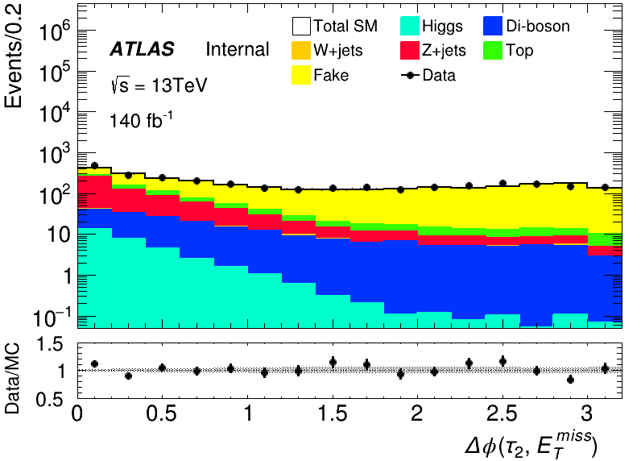
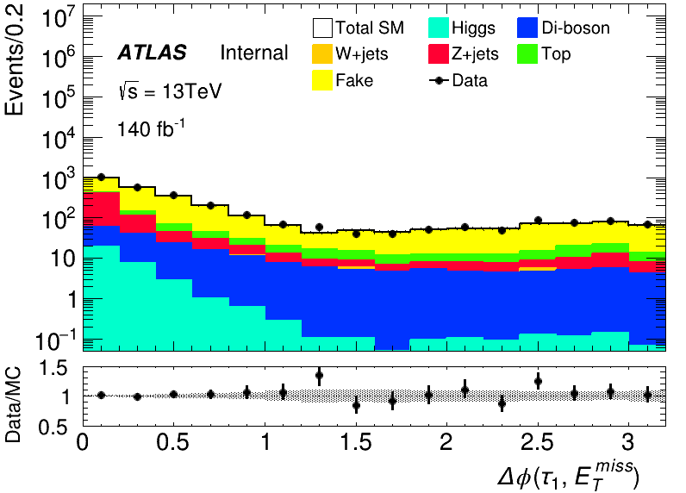
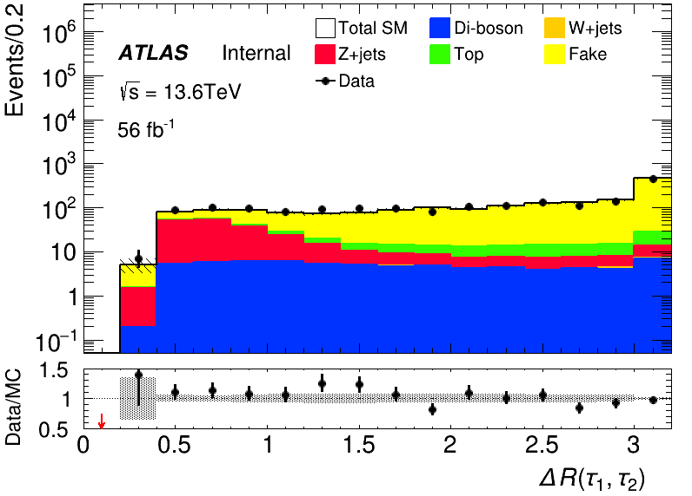
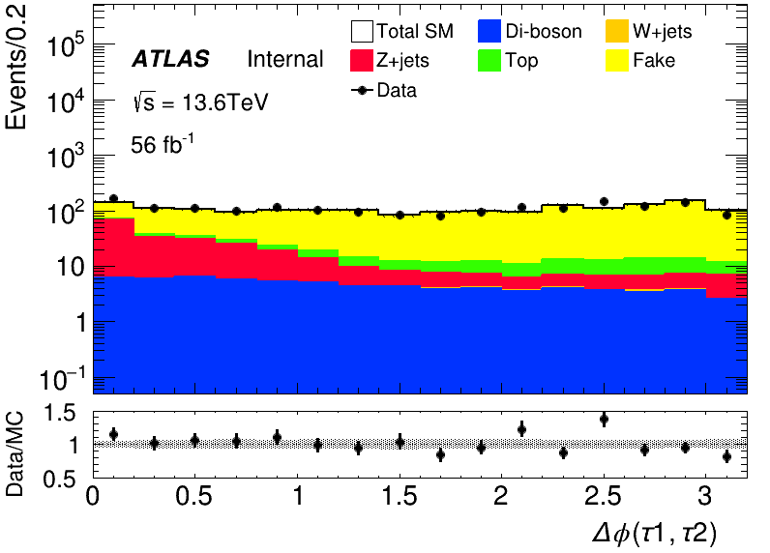
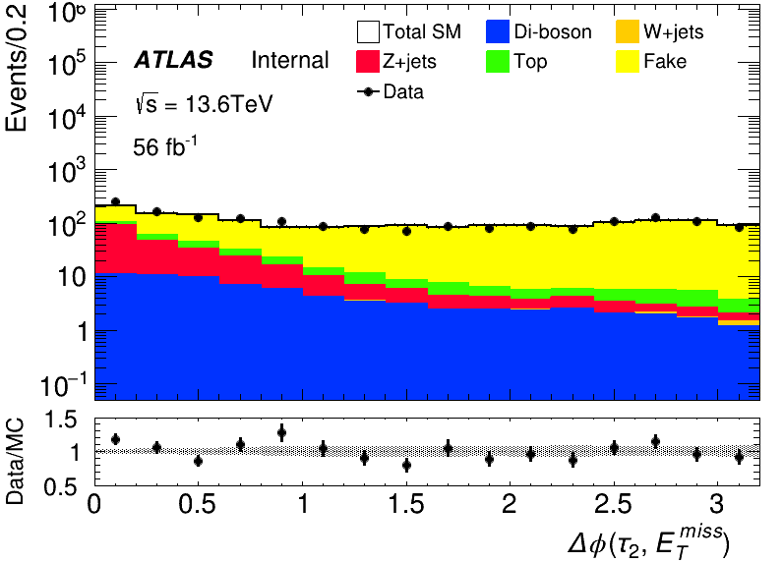
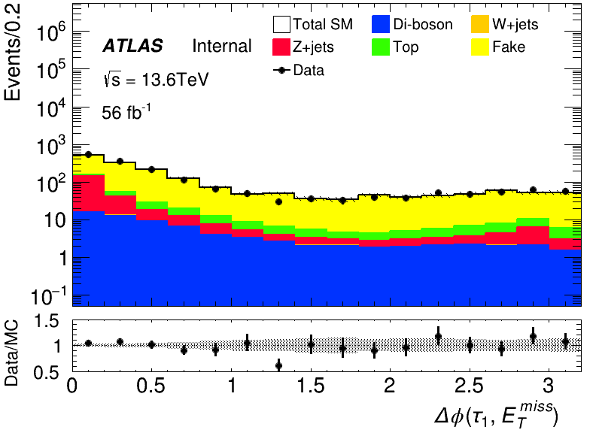
MC modeling in Pre-Selection(HH)
run2
run3

Slide 6
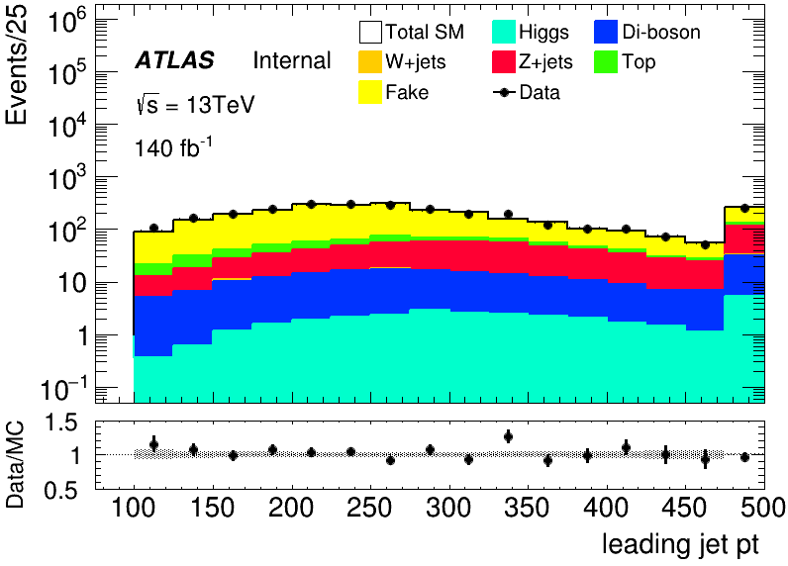
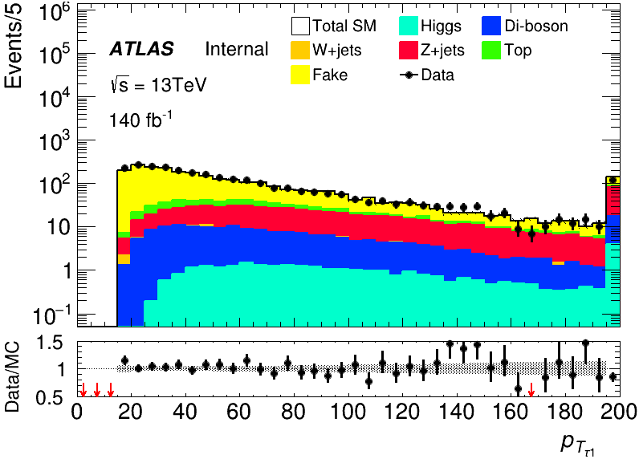
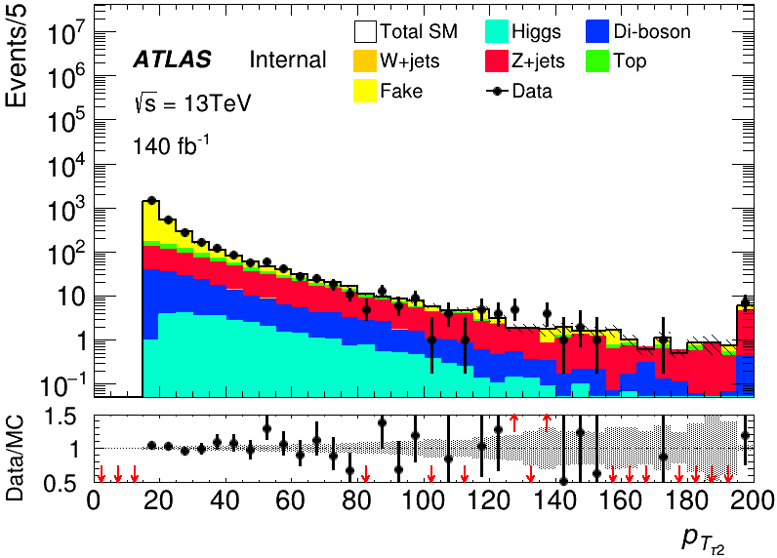
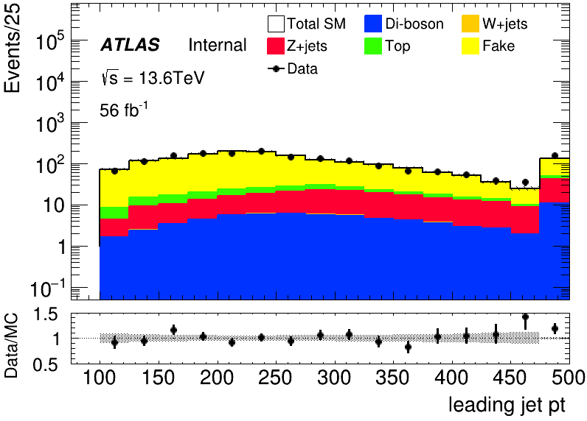
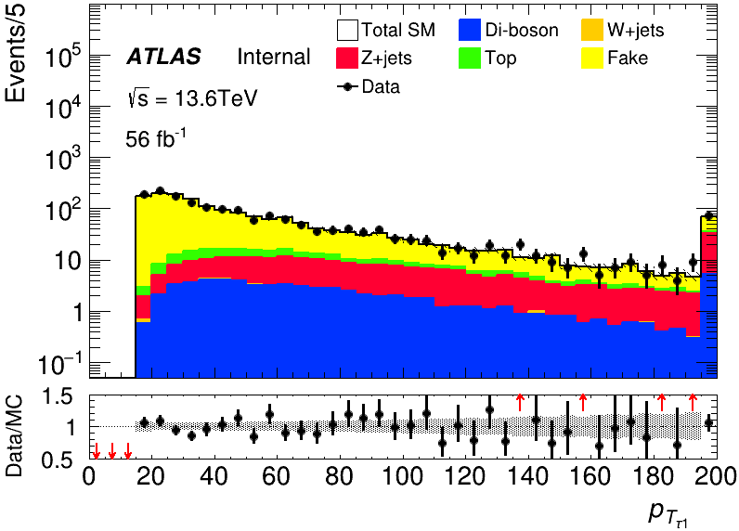
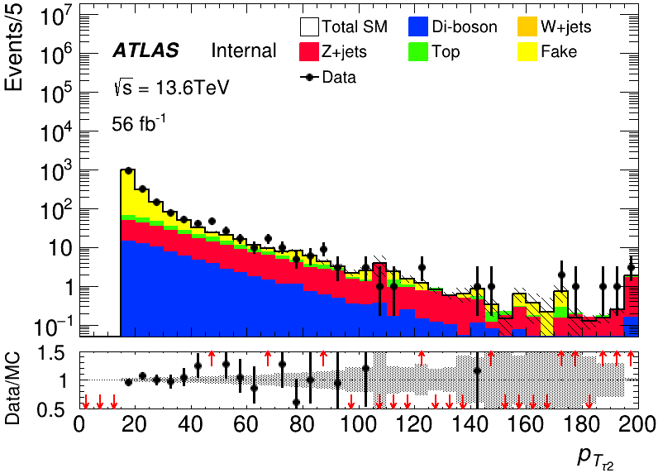
MC modeling in Pre-Selection(HH)
run2
run3

Slide 7
Backup

